Slide 1
Basics of Git & GitHub
Understanding Version Control System
Git vs GitHub
Common Git Commands
Presented : by Abhishek Kumar

Slide 2
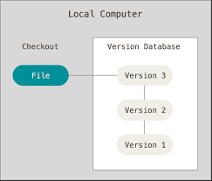
What is Version Control?
System to track changes in files over time
Allows reverting to previous versions
Supports multiple developers working together
Improves code safety and collaboration

Slide 3

What is Git?
Distributed version control system
Tracks source code changes
Works locally on developer machines
Created by Linus Torvalds

Slide 4
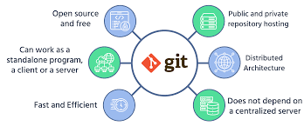
Why Use Git?
Maintains complete code history
Enables team collaboration
Supports branching and merging
Prevents accidental code loss

Slide 5
Basic Terms of Git and GitHub
COMMIT
A commit is a snapshot of the changes made to the files in the repository at a specific point in time.
Commits store information about what was changed, who made the change, and when it was made
BRANCH
The branch concept in GIT is like You can create a branch to work on new features or fix issues without disrupting the main code.
If your changes in the branch are good, you can merge them into the main code. If not, you can make improvements without affecting the main codebase.

Slide 6
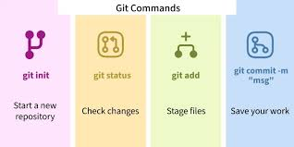
Common Git Commands
git init – Initialize repository
git clone – Copy repository
git status – Check changes
git add – Stage files
git commit – Save snapshot

Slide 7

What is GitHub?
Cloud-based Git repository hosting
Used to store and share code
Supports Pull Requests and Issues
Used widely in software companies

Slide 8
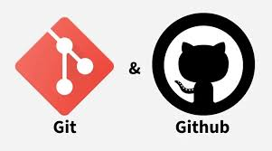
Git vs GitHub
Git: Version control tool (local)
GitHub: Online hosting & collaboration platform
Git tracks changes, GitHub shares them

Slide 9
Conclusion
Git manages code versions
GitHub enables collaboration
Both are essential for modern development

